Slide 1
Chapter 1
Introduction

Slide 2
Processor Trends
10⁸
Transistors (thousands)
10⁷
10⁶
10⁵
10⁴
10³
10²
10¹
10⁰
Source: M. Horowitz, F. Labonte, O. Shacham, K. Olukotun, L. Hammond, C. Batten (1970-2010 ). K. Rupp (2010-2017).
Moore’s “Law” predicted that the number of transistors per unit area would double every 18-24 months

Slide 3
Processor Trends
10⁸
Transistors (thousands)
10⁷
10⁶
10⁵
10⁴
Frequency
(MHz)
10³
10²
10¹
10⁰
Source: M. Horowitz, F. Labonte, O. Shacham, K. Olukotun, L. Hammond, C. Batten (1970-2010 ). K. Rupp (2010-2017).
Processor frequency (clock rate) followed the same trend because smaller transistors can be switched faster… until around 2005.

Slide 4
Processor Trends
10⁸
Transistors (thousands)
10⁷
10⁶
10⁵
10⁴
Frequency
(MHz)
10³
Typical Power
(Watts)
10²
10¹
10⁰
Source: M. Horowitz, F. Labonte, O. Shacham, K. Olukotun, L. Hammond, C. Batten (1970-2010 ). K. Rupp (2010-2017).
Around 2005, frequency stopped increasing due to the power wall (increasing frequency further would make the chip too hot to cool feasibly)

Slide 5
Processor Trends
10⁸
Transistors (thousands)
10⁷
10⁶
Single-thread Performance (SpecINT x 10³)
10⁵
10⁴
Frequency
(MHz)
10³
Typical Power
(Watts)
10²
10¹
10⁰
Source: M. Horowitz, F. Labonte, O. Shacham, K. Olukotun, L. Hammond, C. Batten (1970-2010 ). K. Rupp (2010-2017).
Stagnation in frequency led to a stagnation in single-thread performance, except for some improvements due to architecture and compiler advancements

Slide 6
Processor Trends
10⁸
Transistors (thousands)
10⁷
10⁶
Single-thread Performance (SpecINT x 10³)
10⁵
10⁴
Frequency
(MHz)
10³
Typical Power
(Watts)
10²
Number of Logical Cores
10¹
10⁰
Source: M. Horowitz, F. Labonte, O. Shacham, K. Olukotun, L. Hammond, C. Batten (1970-2010 ). K. Rupp (2010-2017).
Stagnation in single-thread performance made parallel computing mainstream as transistors were invested in adding more cores to processors

Slide 7

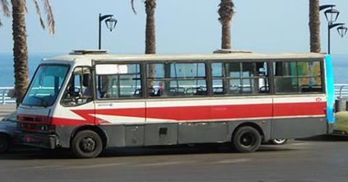
Design Approaches
Latency-Oriented Design
Throughput-Oriented Design
Minimize the time it takes to perform a single task
Maximize the number of tasks that can be performed in a given time frame

Slide 8
Processor Design Approaches
CPU: Latency-Oriented Design
GPU: Throughput-Oriented Design
Control
ALU
ALU
ALU
ALU
Cache
A few powerful ALUs
Reduced operation latency
Large caches
Convert long latency memory accesses to short latency cache accesses
Sophisticated control
Branch prediction to reduce control hazards
Data forwarding to reduce data hazards
Modest multithreading to hide short latency
High clock frequency
Many small ALUs
Long latency, high throughput
Heavily pipelined for further throughput
Small caches
More area dedicated to computation
Simple control
More area dedicated to computation
Massive number of threads to hide the very high latency!
Moderate clock frequency

Slide 9
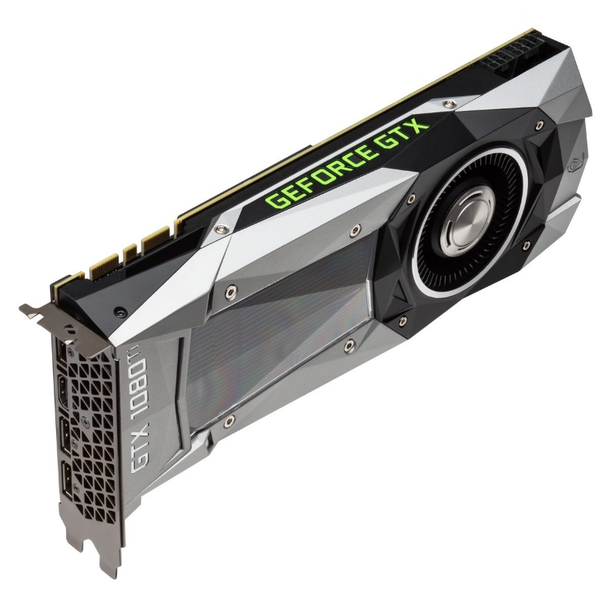
GPU Origins
GPUs were originally built for graphics
Hence the name, Graphics Processing Unit
Graphics workloads process a massive number of pixels in parallel
Before 2007, the only way to program GPUs was using graphics APIs
e.g., OpenGL, Direct3D
Using GPUs for other than graphics meant reformulating a computation as a function that paints a pixel
In 2007, NVIDIA released CUDA
A programming interface for using GPUs in a general purpose way
Requires extensions to the GPU architecture

Slide 10
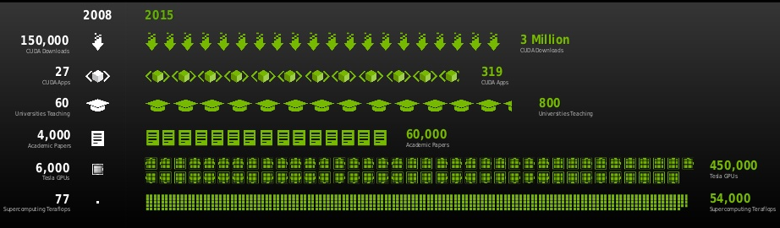
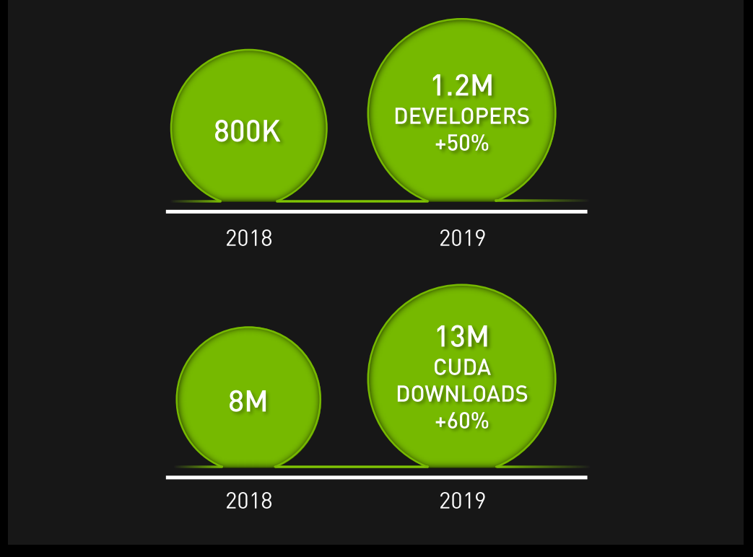
Growth of GPU Computing
Source: Jensen Huang, GTC’15 Keynote
Source: Jensen Huang, GTC’19 Keynote

Slide 11
Top Supercomputers
Source: top500.org, November 2021
GPU accelerated computers in 2020:
#1 in USA, #2 worldwide – Summit
#1 in Europe, #8 worldwide – Juwels
7 out of the top 10 supercomputers worldwide
#2 in energy-efficient supercomputers (Green500)
9 out of top 10 energy-efficient supercomputers

Slide 12
Why GPUs?
Chips are expensive to build and require a large volume of sales to amortize the cost
This makes the chip market very difficult to penetrate
When parallel computing became mainstream, GPUs already had (and still have) a large installed base from the gaming sector
Gave them a head start compared to other potential massively parallel accelerators

Slide 13
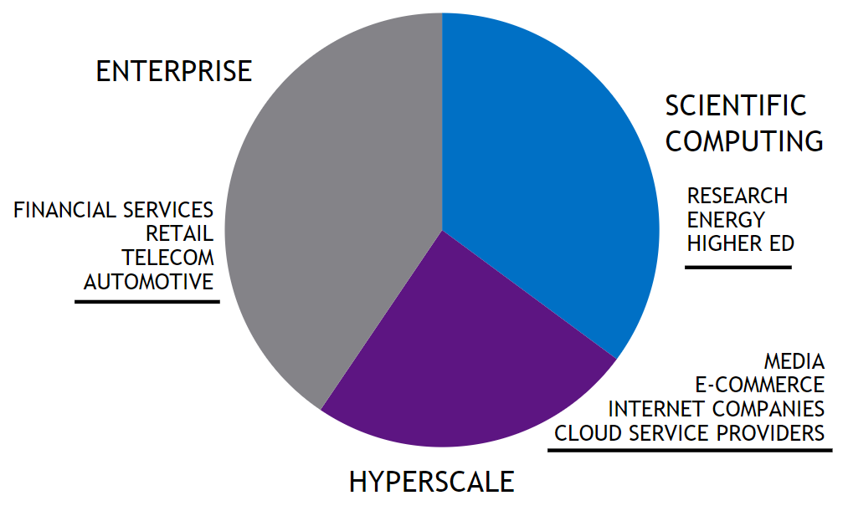
GPU Market Sector Breakdown
Revenue from Different Market Sectors
Breakdown of Datacenter Sector
Source: NVIDIA, 2018
Source: NVIDIA, Q2 FY19

Slide 14
Parallel Programming Frameworks
In this class, we will focus on CUDA
Other GPU parallel programming frameworks:
OpenCL
OpenACC
Popular CPU programming frameworks
MPI (distributed memory system)
OpenMP (shared memory system)
Both can be used in conjunction with CUDA

Slide 15
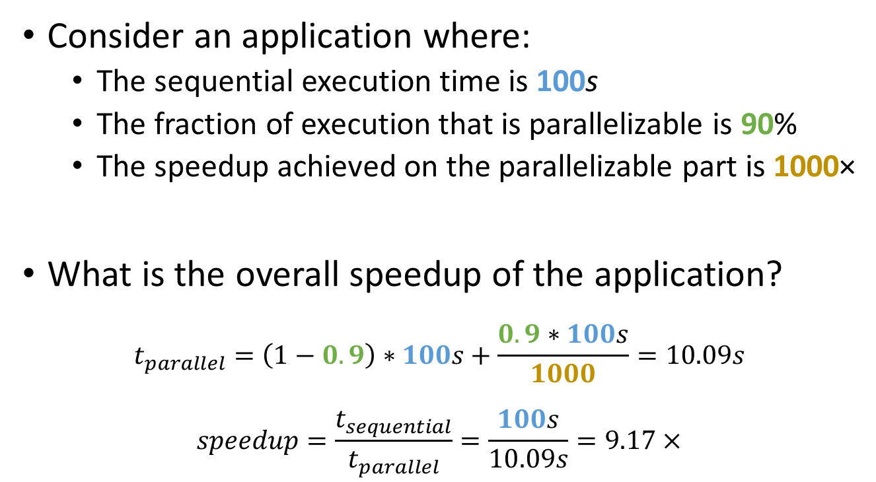
Parallel Computing Pitfall
Consider an application where:
The sequential execution time is 100s
The fraction of execution that is parallelizable is 90%
The speedup achieved on the parallelizable part is 1000×
What is the overall speedup of the application?
$$t_{parallel}=\left(1−0.9\right)∗100s+\frac{0.9∗100s}{1000}=10.09s$$
$$speedup=\frac{t_{sequential}}{t_{parallel}}=\frac{100s}{10.09s}=9.17×$$

Slide 16
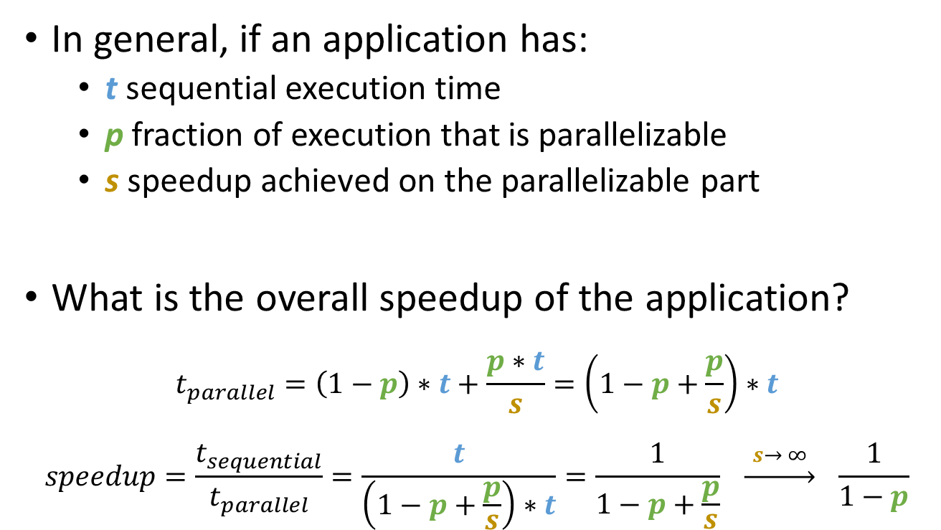
Amdahl’s Law
In general, if an application has:
t sequential execution time
p fraction of execution that is parallelizable
s speedup achieved on the parallelizable part
What is the overall speedup of the application?
$$t_{parallel}=\left(1−p\right)∗t+\frac{p∗t}{s}=\left(1−p+\frac{p}{s}\right)∗t$$
$$speedup=\frac{t_{sequential}}{t_{parallel}}=\frac{t}{\left(1−p+\frac{p}{s}\right)∗t}=\frac{1}{1−p+\frac{p}{s}} \underset{→}{ s→ ∞ } \frac{1}{1−p}$$

Slide 17
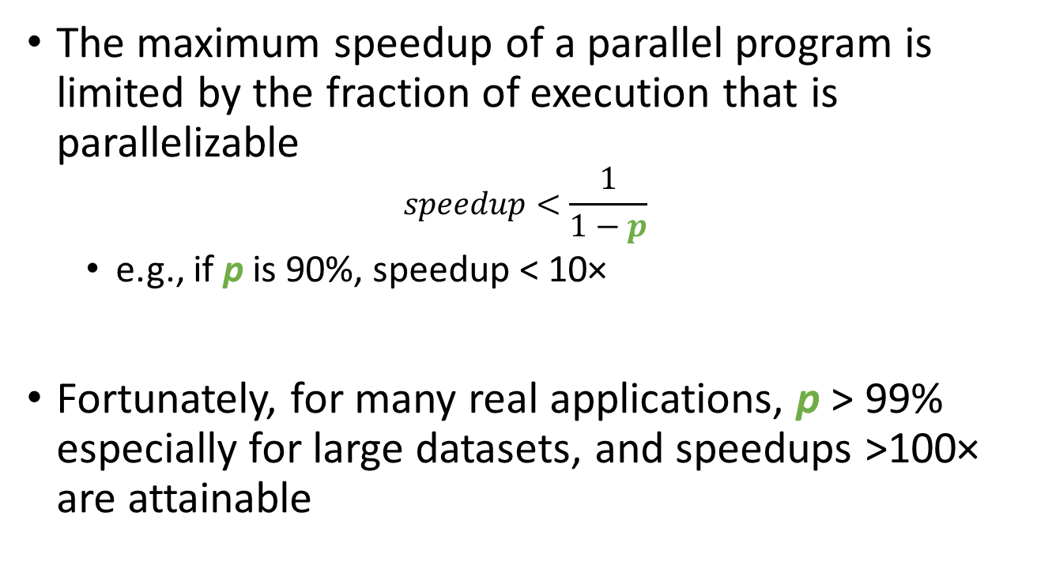
Amdahl’s Law Implications
The maximum speedup of a parallel program is limited by the fraction of execution that is parallelizable
$$speedup<\frac{1}{1−p}$$
e.g., if p is 90%, speedup < 10×
Fortunately, for many real applications, p > 99% especially for large datasets, and speedups >100× are attainable

Slide 18
References
Wen-mei W. Hwu, David B. Kirk, and Izzat El Hajj. Programming Massively Parallel Processors: A Hands-on Approach. Morgan Kaufmann, 2022.

